Slide 1
Camera Calibration in Computer Vision
Rhichard Koh

Slide 2

What is Computer Vision?
Definition: Computer Vision is a field of artificial intelligence that enables computers and systems to derive meaningful information from digital images, videos, and other visual inputs. It also take actions or make recommendations based on that information.
Objective: The ultimate goal is to mimic the way humans perceive and understand visual information.
Key Components: Image acquisition, processing, analysis, and understanding.

Slide 3
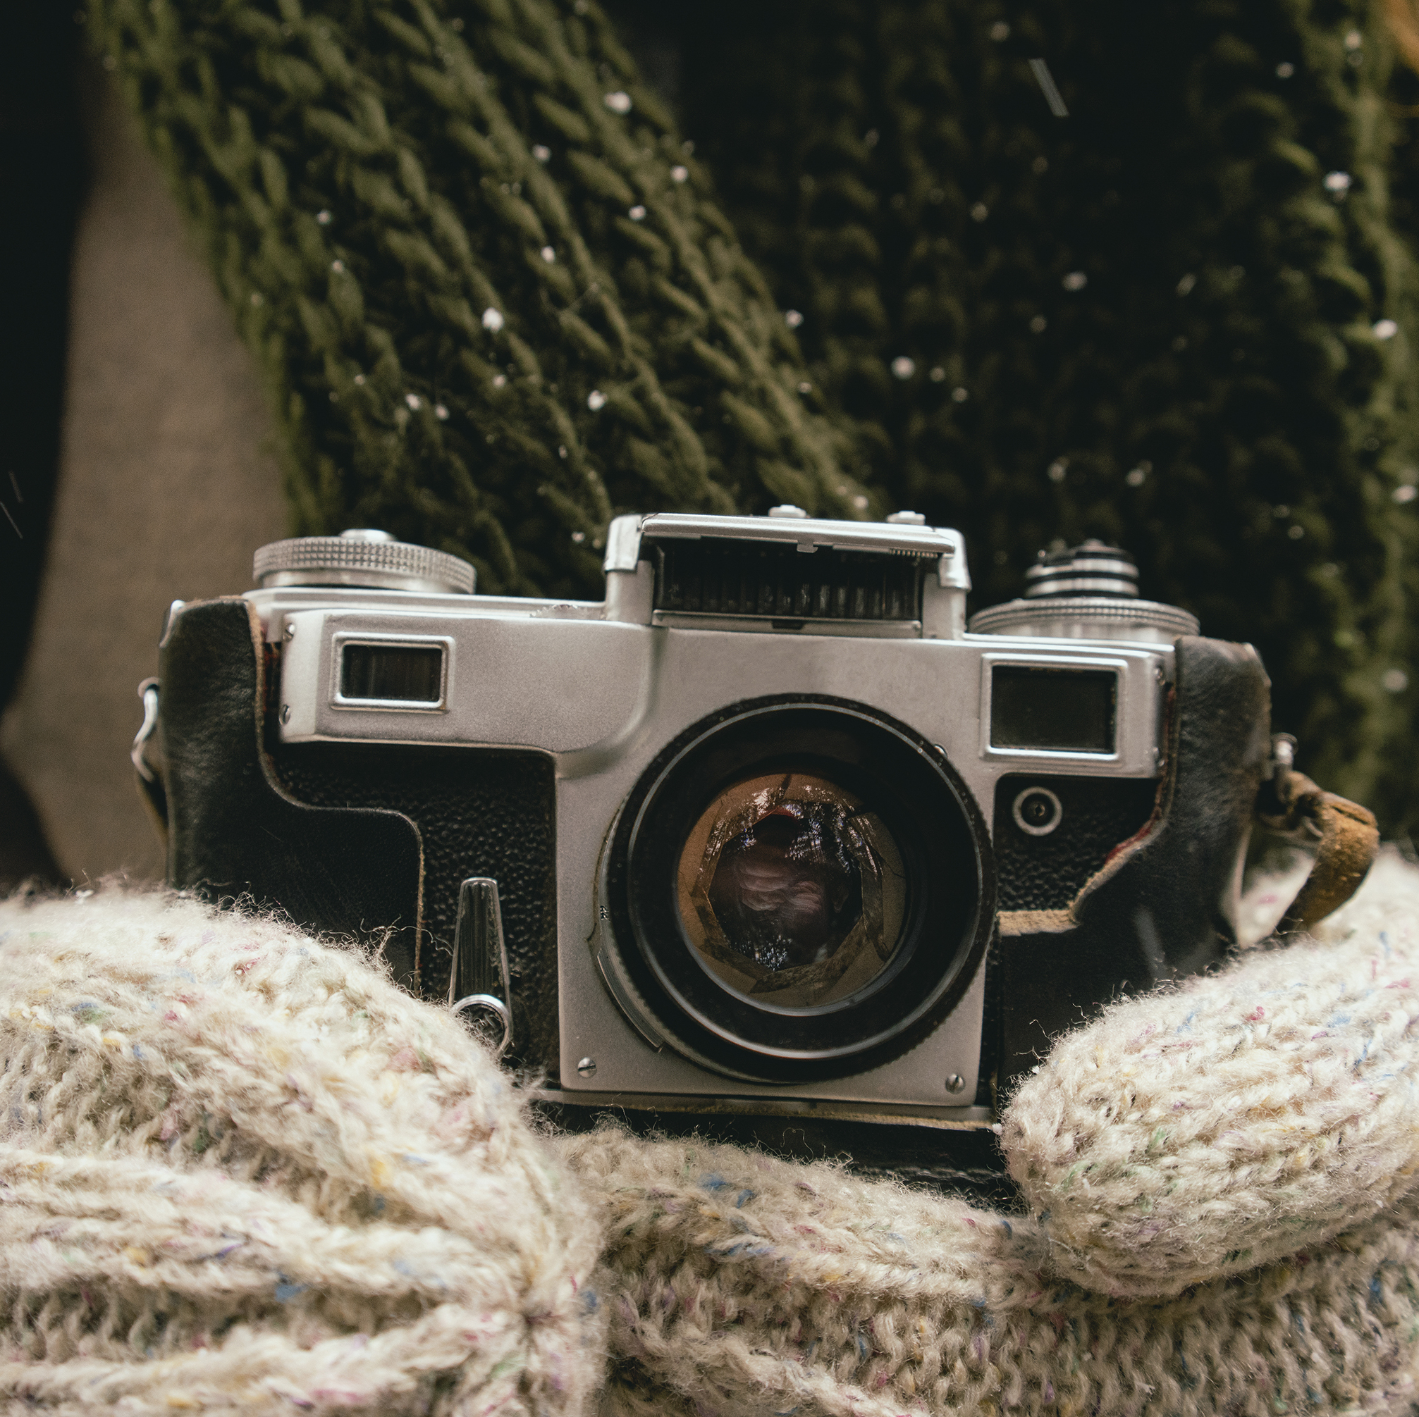
Accurate Image Capture in Computer Vision
The accuracy of computer vision systems heavily depends on the quality and precision of the captured images.
Factors like lighting, perspective, distortion, and resolution can affect image quality and, consequently, the performance of computer vision algorithms.
Camera calibration is a critical step to correct distortions and ensure that the captured images accurately represent the real world.

Slide 4
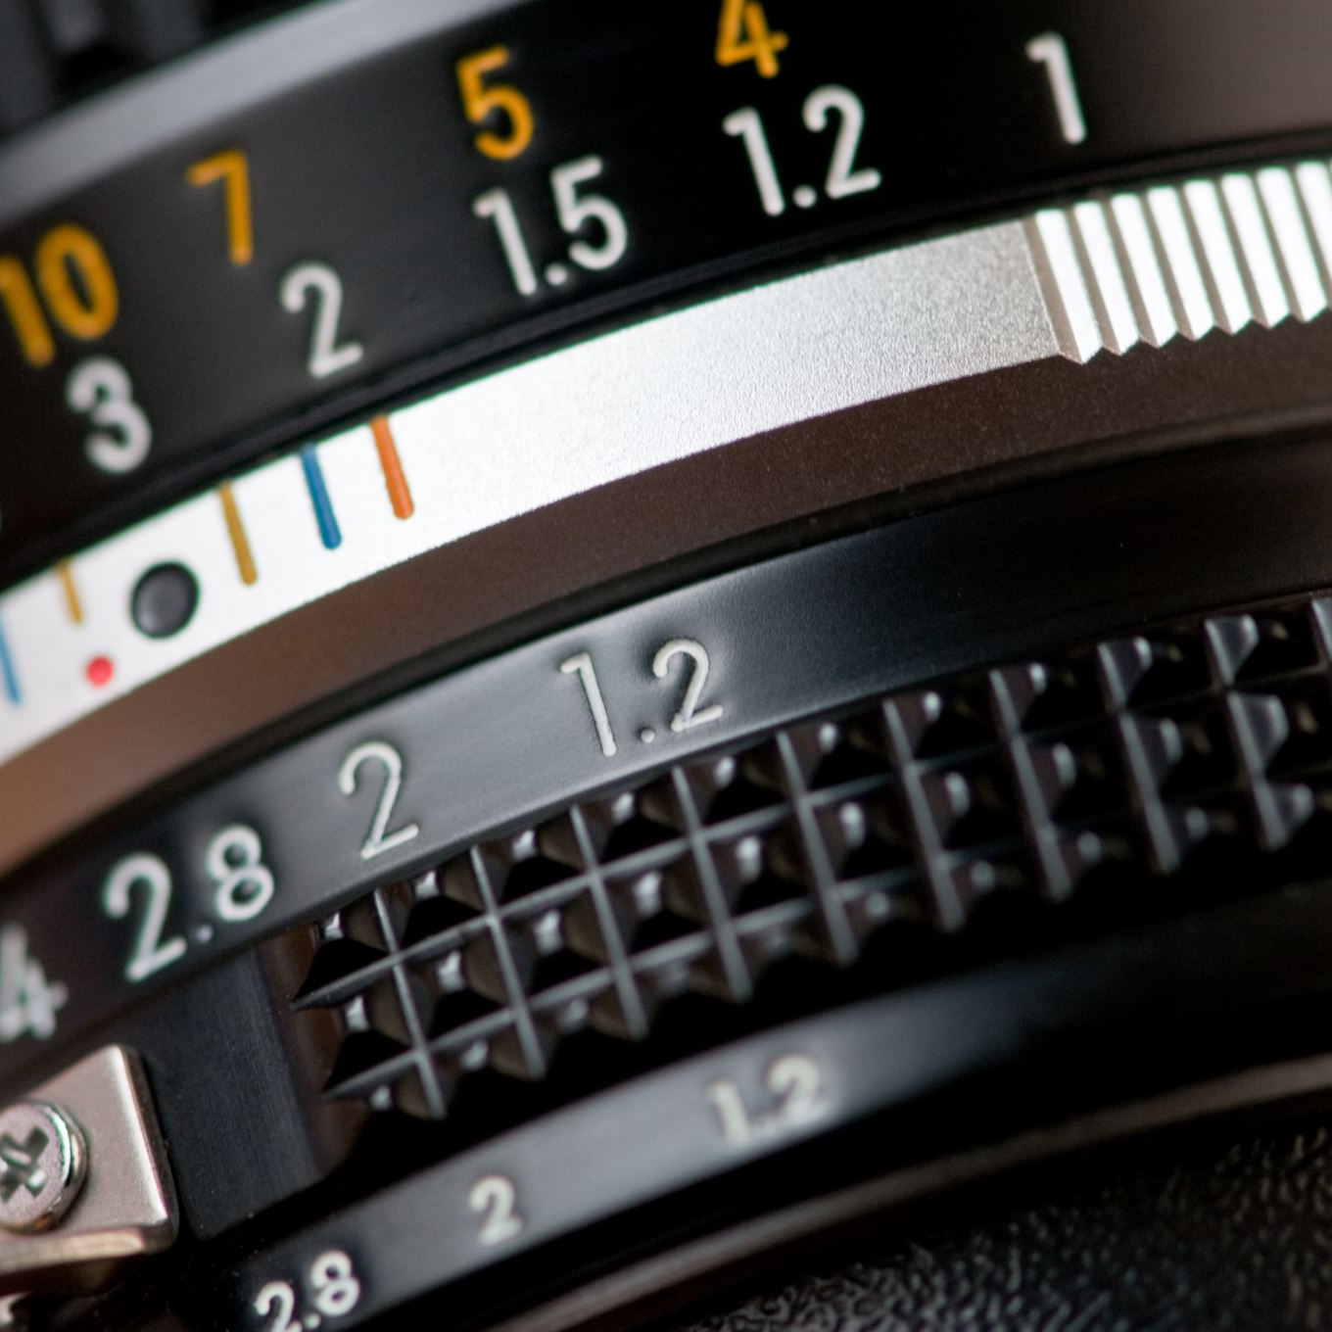
What is Camera Calibration?
Camera calibration is the process of estimating the parameters of the lens and the image sensor of a camera to improve the accuracy of the images it captures.
The main goal is to measure and correct the imperfections in the images caused by optical distortion, ensuring that the captured representations are as close to reality as possible.

Slide 5
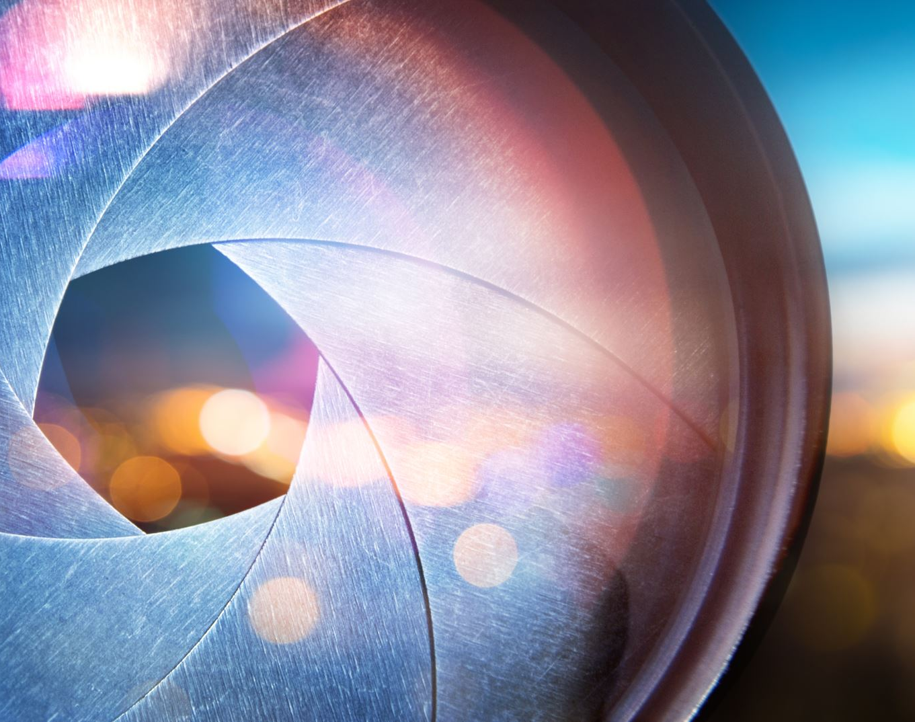
Why is it Important?
Calibration ensures that computer vision algorithms interpret the captured images accurately, which is crucial for applications requiring precise measurements, such as 3D reconstruction and robotic navigation.
Addresses issues like radial and tangential lens distortion, which can significantly alter the perceived shapes and sizes in an image.

Slide 6
Intrinsic vs. Extrinsic Parameters
Camera parameters are divided into two main categories: intrinsic and extrinsic.
Intrinsic Parameters: Relate to the camera's internal characteristics.
Extrinsic Parameters: Define the camera's position and orientation in the setting.

Slide 7
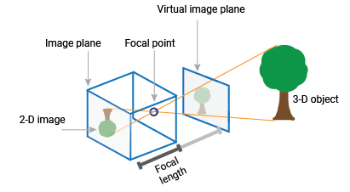
Intrinsic Parameters
Focal Length: The distance between the camera sensor and the lens center, affecting the field of view and magnification of the image.
Focal Point: The point on the image sensor where the light rays converge, typically assumed to be at the center of the image.
Distortion Coefficients: Parameters that quantify the deviation of the lens from a perfect pinhole model, including radial and tangential distortion factors.

Slide 8
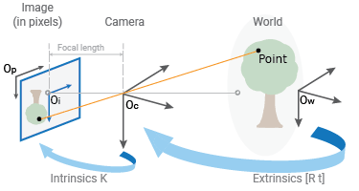
Extrinsic Parameters
Position: The location of the camera in a world coordinate system, often represented as a translation vector.
Orientation: The angle at which the camera is pointed, typically described using rotation matrices or Euler angles.
Importance in 3D Space: These parameters are crucial for understanding how the camera relates to the scene it captures, enabling accurate mapping of 2D images to 3D models.

Slide 9
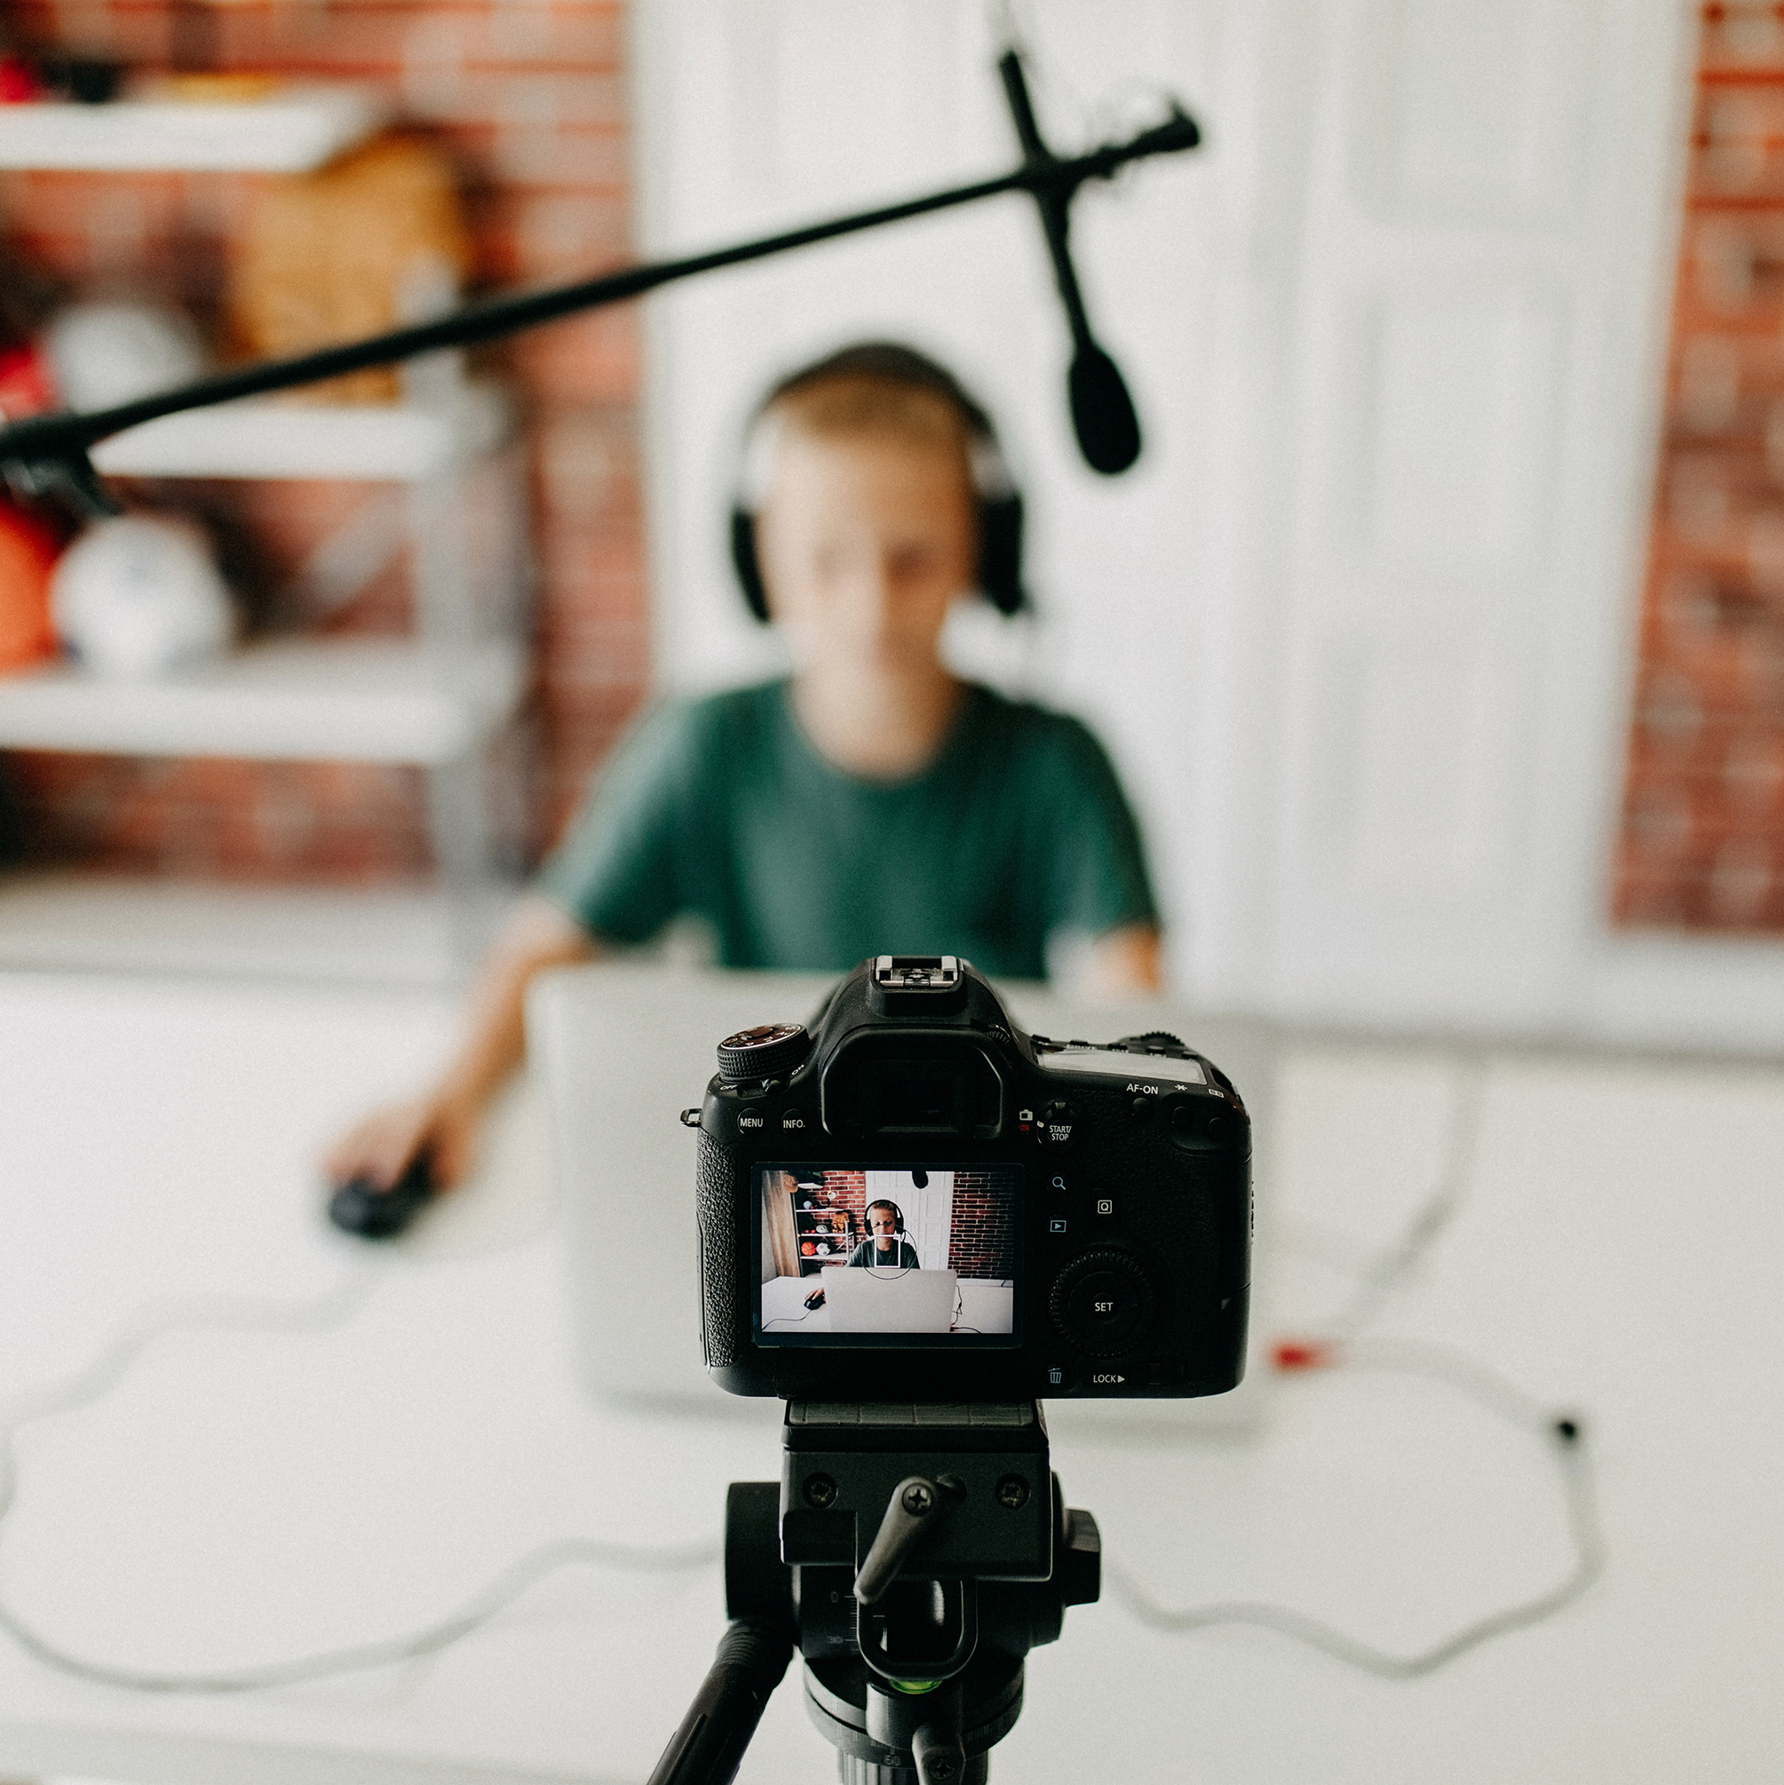
Implications of Calibration
Enhanced Image Quality: Calibration allows for the correction of optical distortions, leading to clearer and more accurate images.
Improved Measurement Precision: In applications like augmented reality and robotics, precise calibration is essential for overlaying virtual objects accurately onto the real world and for navigating physical spaces.

Slide 10
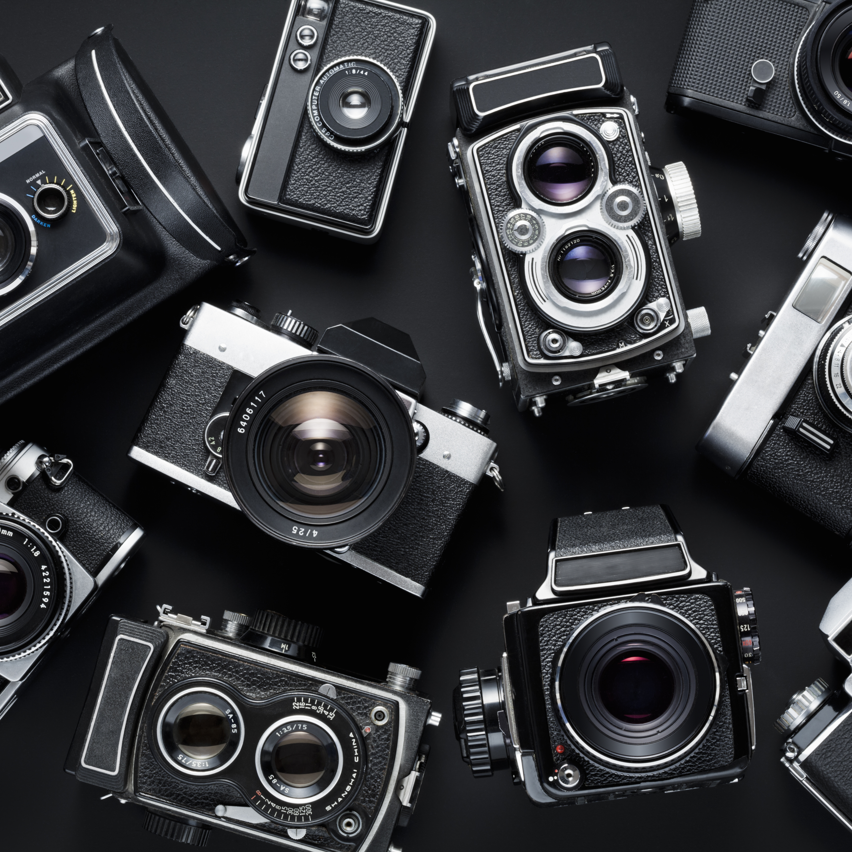
Camera Calibration Methods
Geometric Calibration Techniques
Self-Calibration Methods
Machine Learning Approaches

Slide 11
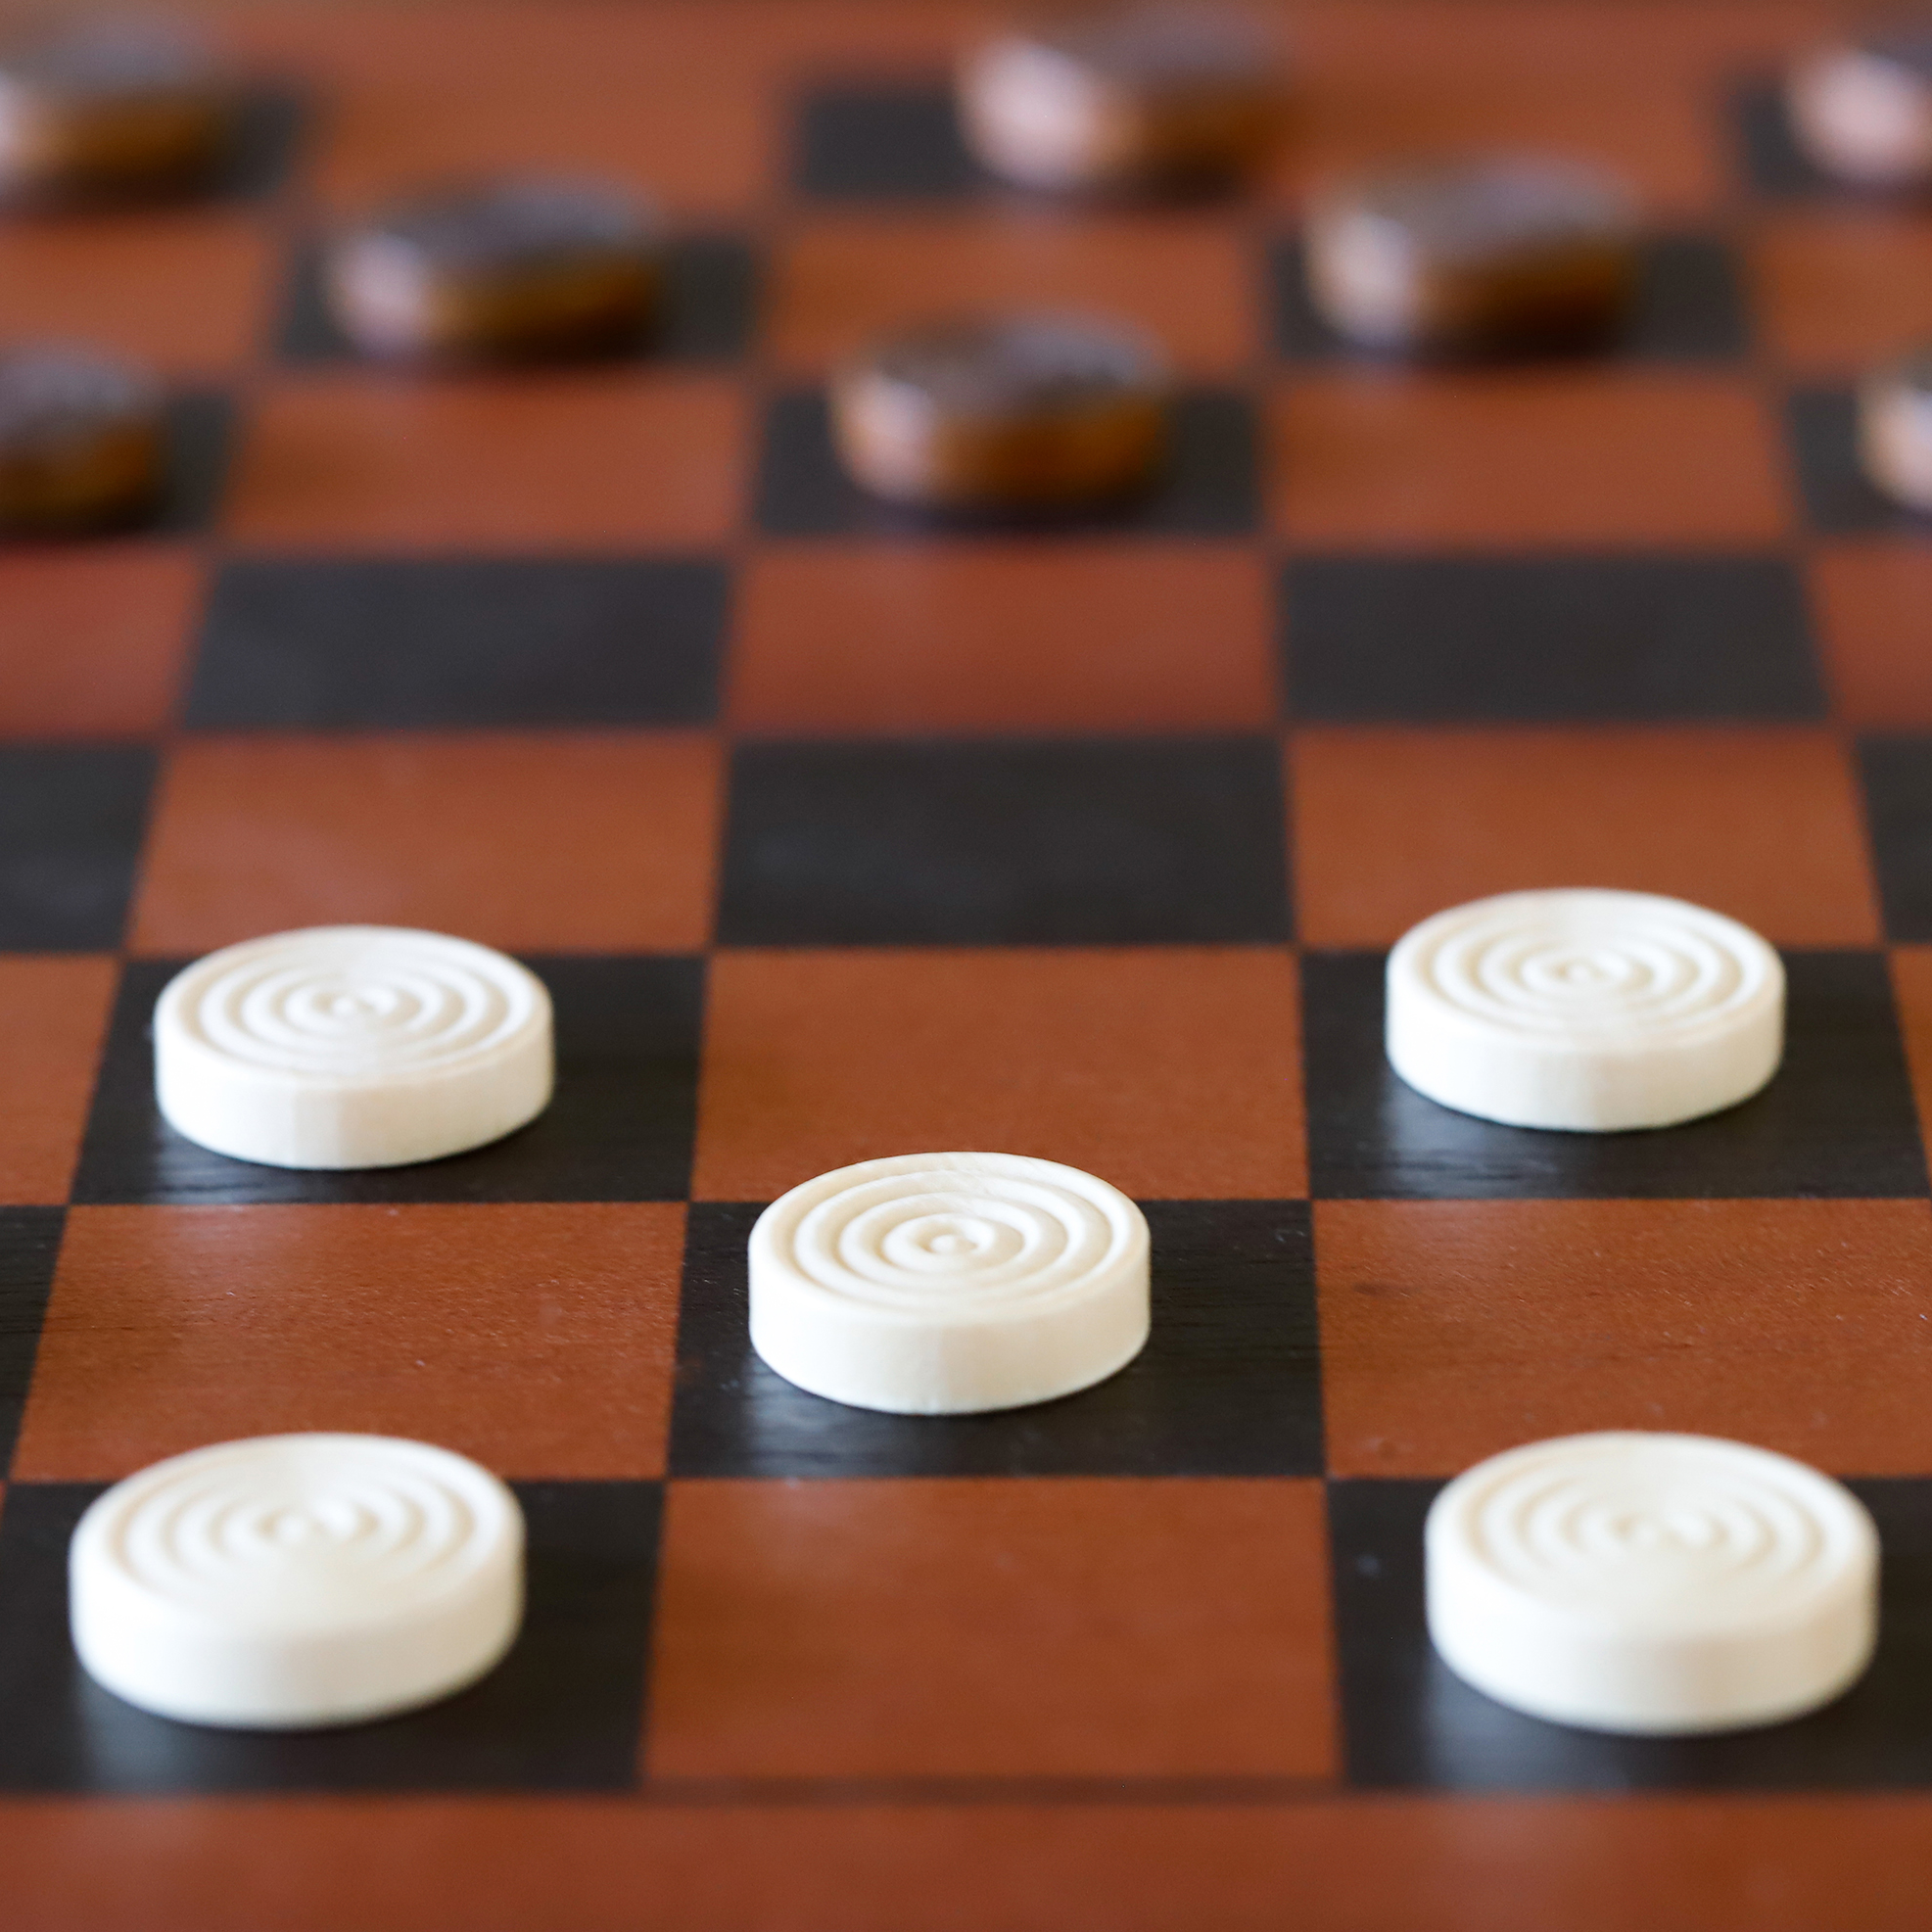
Geometric Calibration
Geometric Calibration leverages known patterns to precisely estimate camera parameters.
Utilizes easily recognizable patterns, such as chessboards or dot patterns, as references.
Captures multiple images of the pattern from different angles and distances.
Employs algorithms to detect specific pattern features (e.g., corners in a chessboard).
Analyzes the spatial relationship between the 2D image features and their known 3D positions to compute the camera's intrinsic and extrinsic parameters.

Slide 12
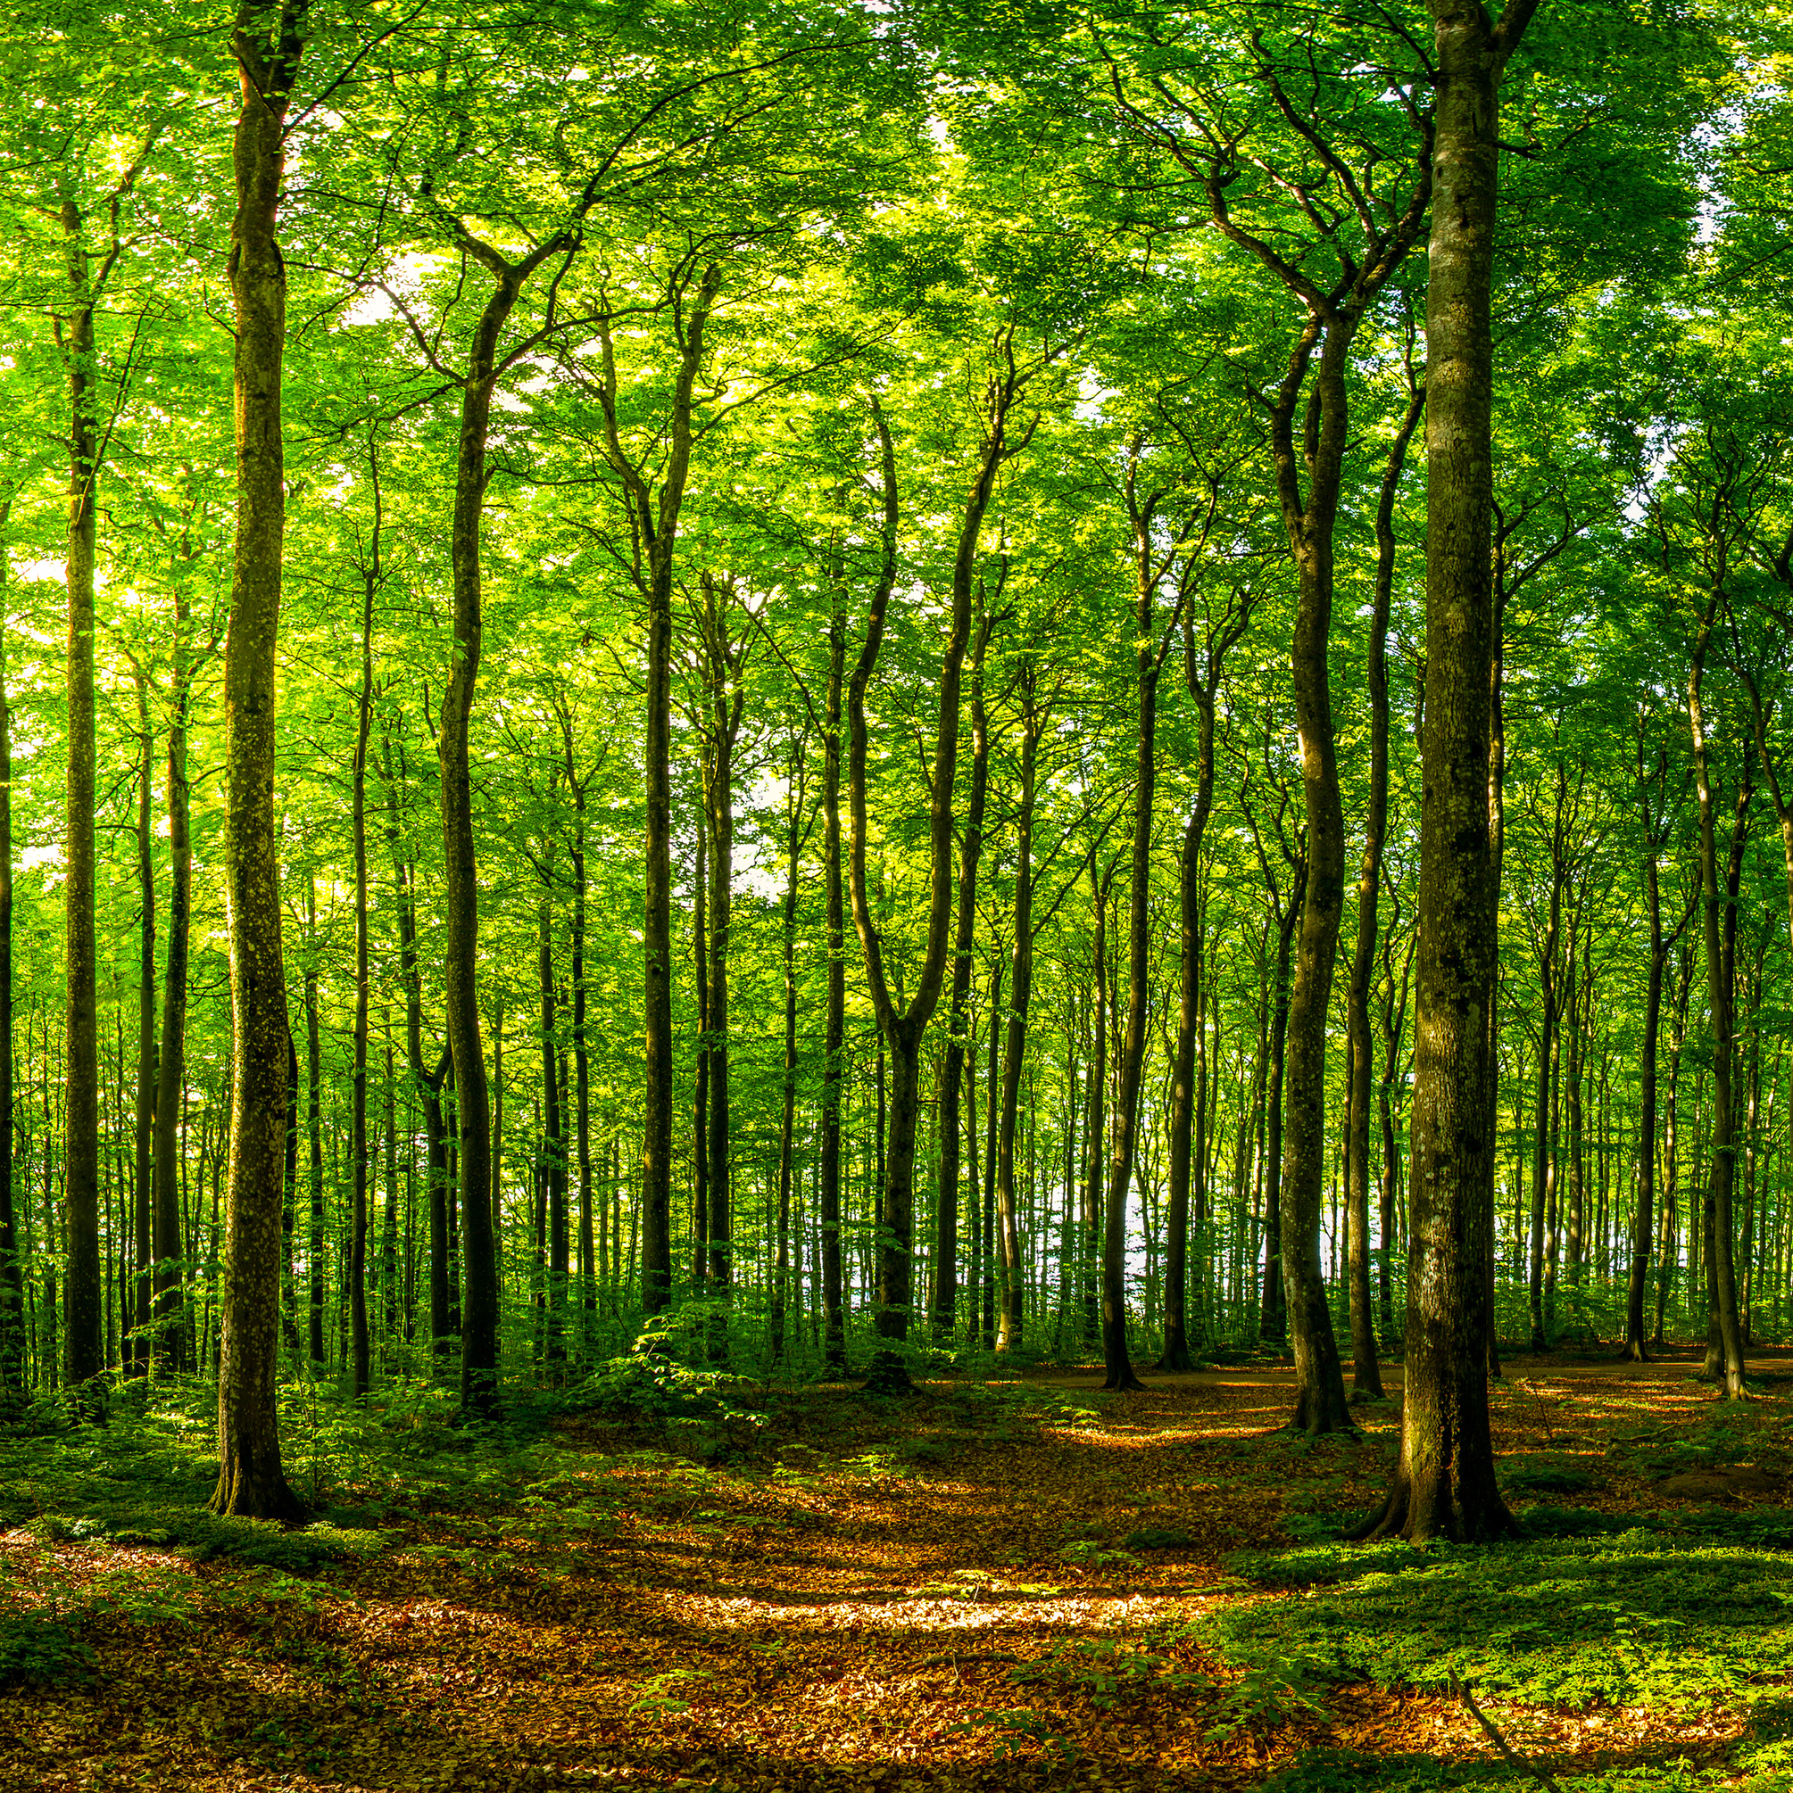
Self-Calibration Methods
Self-Calibration derives camera parameters directly from images of the scene, without requiring a specific calibration object.
Eliminates the need for specific calibration patterns, utilizing natural scene features instead.
Leverages geometric properties of the scene (e.g., parallel lines, planar surfaces) and motion between views to estimate camera parameters.
Common techniques include exploiting vanishing points, planar homographies, and the epipolar geometry of multiple views.
Ideal for scenarios where introducing a calibration pattern is impractical or impossible, such as in post-production of film or in large-scale outdoor environments.

Slide 13
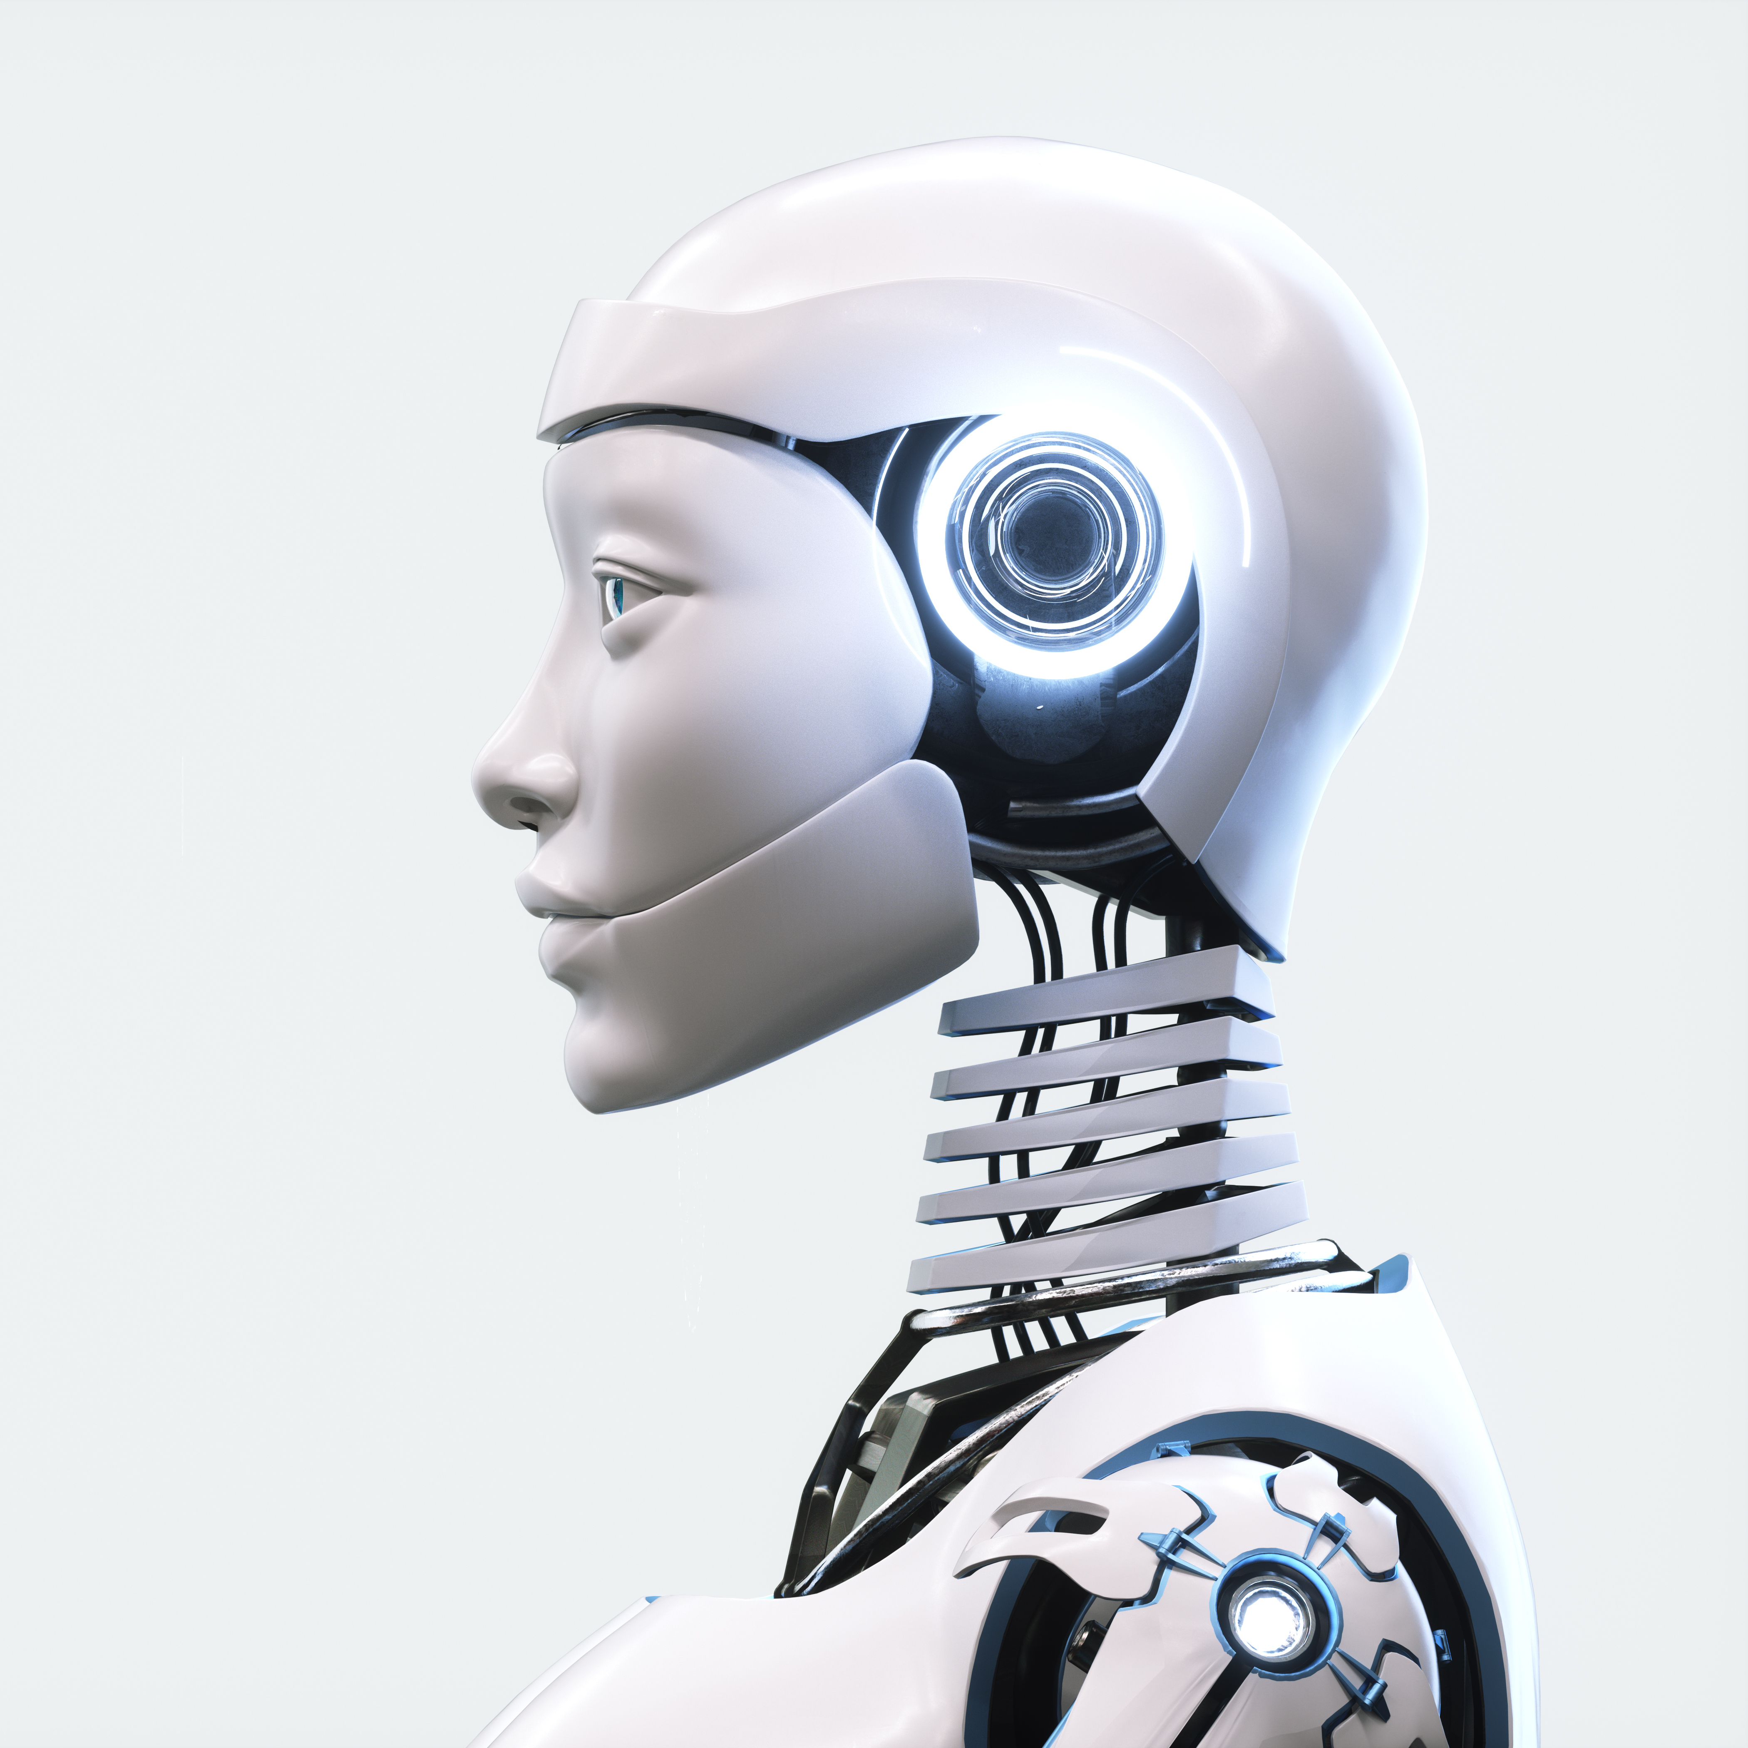
Machine Learning Approaches
Machine Learning Approaches utilize AI models to estimate camera parameters directly from images, bypassing conventional calibration steps.
Incorporates deep learning techniques to predict intrinsic and extrinsic camera parameters.
Relies on extensive datasets of images with known calibration parameters to train the models.
Continuous improvements with advancements in neural network architectures and training techniques.
Particularly useful in dynamic environments where traditional calibration is impractical, such as in mobile devices or for online calibration in autonomous systems.

Slide 14
Method | Geometric Calibration | Self-Calibration | Machine Learning
Key Features | Uses known patterns like chessboards | No specific patterns needed, uses scene features | Uses deep learning to estimate parameters
Advantages | High precision, well-understood | Flexible, can be used in post-production | Can quickly adapt to different environments, minimal setup
Challenges | Requires specific setup and patterns | Potentially less accurate than geometric methods | Requires extensive training data, may lack transparency
Best For | Laboratory settings, 3D modeling | Situations where calibration patterns cannot be used, outdoor environments | Dynamic or varied environments, applications needing rapid setup

Slide 15
Step-by-Step Calibration Process
Choose a controlled environment with consistent lighting.
Position the calibration pattern on a stable, flat surface.
Take multiple images of the calibration pattern from various angles and distances to cover the camera's entire field of view.
Ensure the pattern is well-focused and occupies a significant portion of the frame in each image.
Use image processing algorithms to identify specific features within the pattern (e.g., corners in a chessboard pattern).
Ensure accurate and consistent feature detection across all images.
Associate detected 2D image points with their corresponding 3D points on the calibration pattern.
Employ optimization techniques to solve for the camera's intrinsic and extrinsic parameters, minimizing the re-projection error.

Slide 16
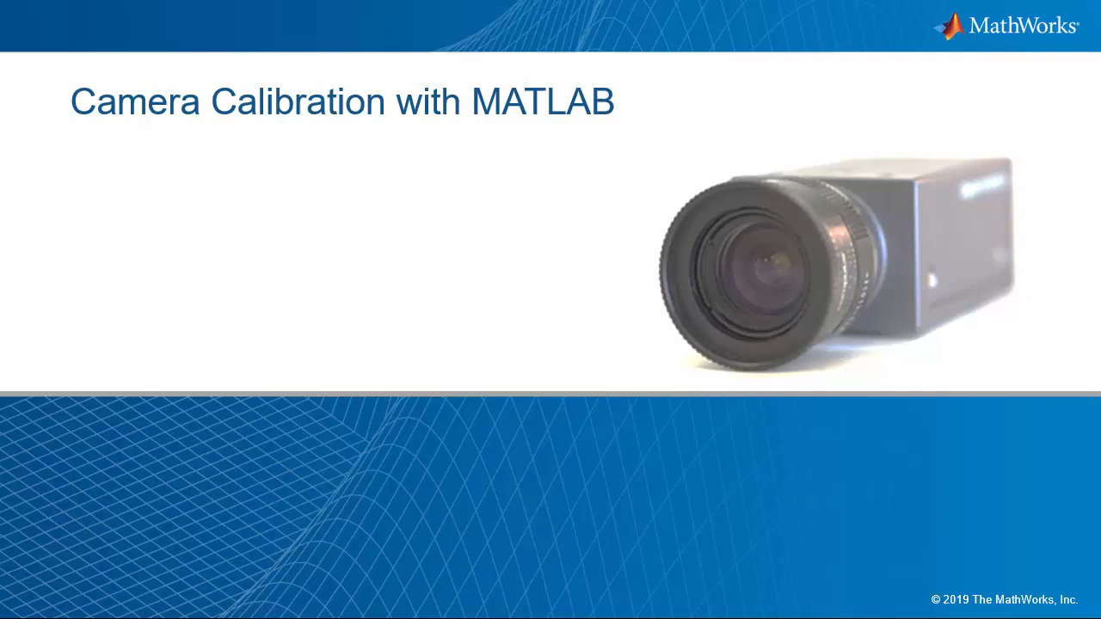
Step-by-Step Calibration Process

Slide 17
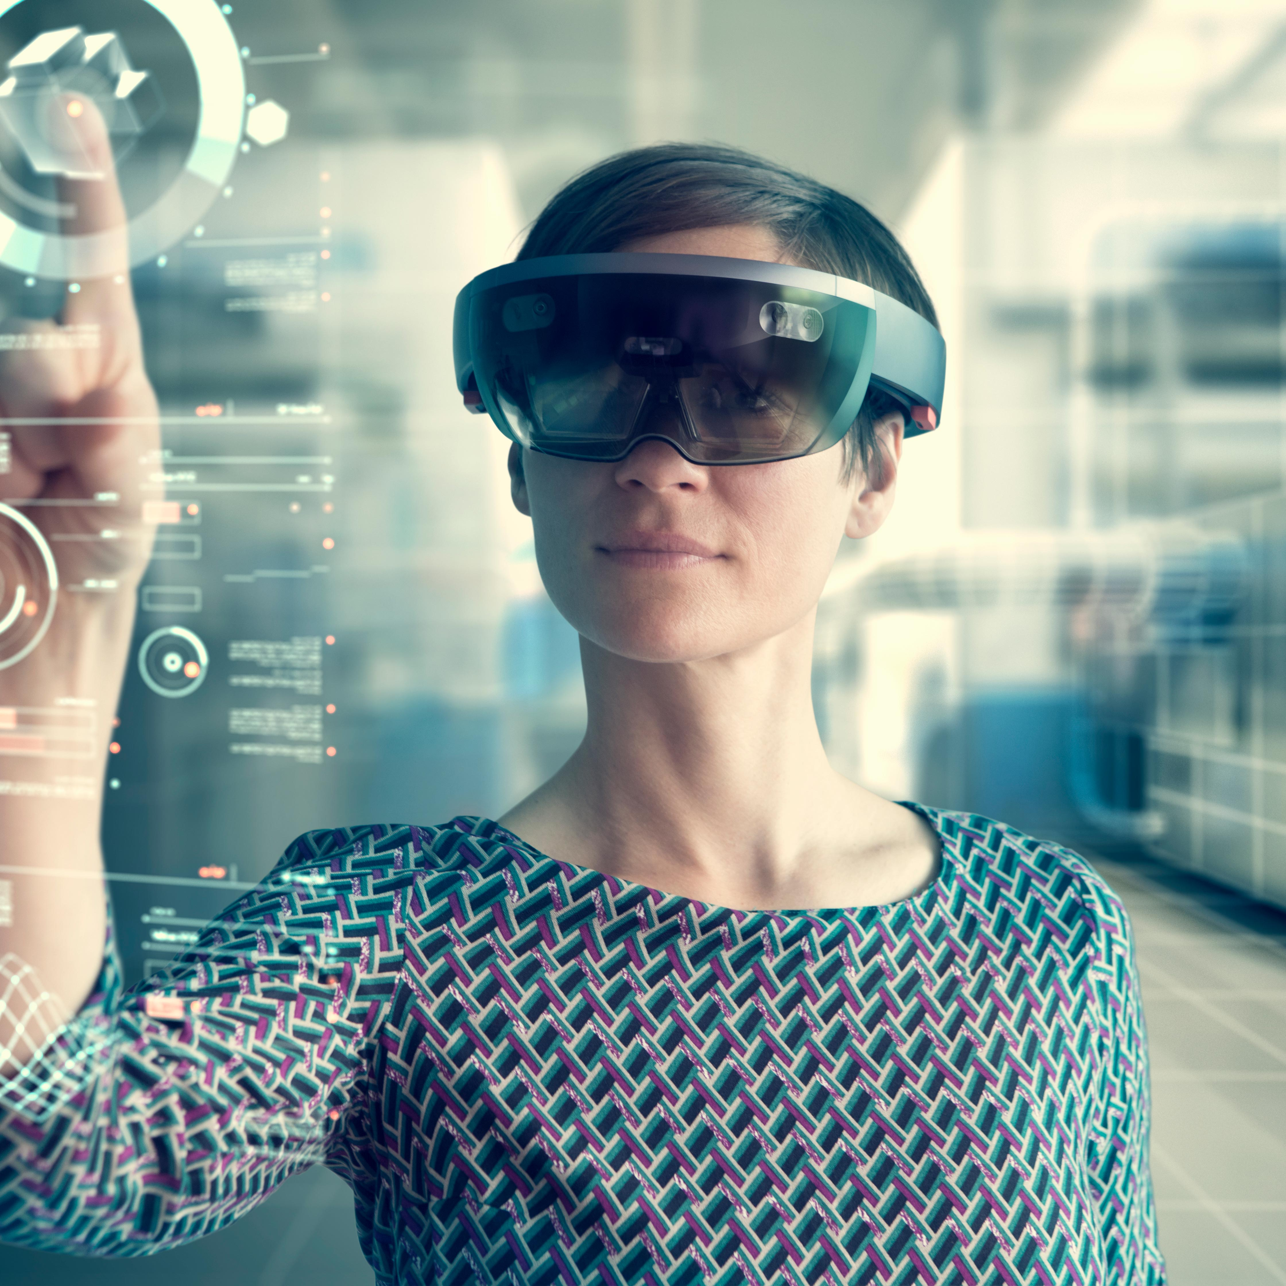
Applications of Camera Calibration
3D Reconstruction: Transforms 2D image data into precise 3D models for applications in architecture, archaeology, and virtual reality.
Robotics: Empowers robots with spatial awareness, critical for navigation, object manipulation, and interaction with their environment.
Augmented Reality (AR): Ensures the accurate placement and integration of virtual objects in real-world environments, enhancing user experience in gaming, education, and retail.
Autonomous Vehicles: Improves the interpretation of sensor data, crucial for object detection, traffic analysis, and decision-making in self-driving cars.

Slide 18

Challenges in Camera Calibration
Wide-Angle and Fisheye Lenses: These lenses introduce severe distortion, complicating the calibration process. Standard calibration models may not be sufficient, requiring specialized algorithms and models.
Precision in Feature Detection: High precision is essential for detecting and matching features across images, especially in geometric calibration methods. Inaccuracies in feature detection can lead to significant errors in the estimated camera parameters.
Environmental Influences: Calibration accuracy can be significantly impacted by environmental factors such as variable lighting, reflections, and shadows. Ensuring consistent environmental conditions or developing robust calibration methods is crucial.

Slide 19
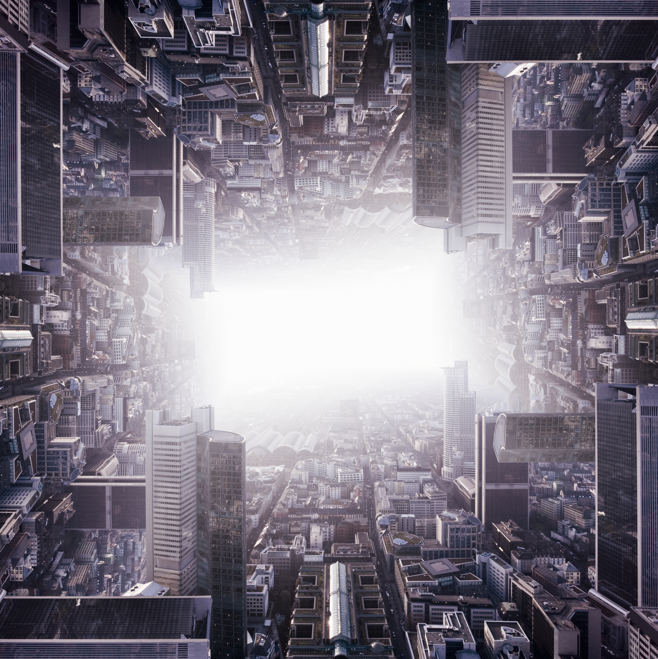
Recent Advances and Future Directions in Camera Calibration
Recent Advances:
Adaptive Calibration Techniques: These methods automatically fine-tune the camera's settings when things like light or movement change. They keep checking and updating these settings to make sure the camera always works well.
Integration of Machine Learning: Machine learning helps cameras adjust their settings and fix image flaws on their own, working well in many different situations and with various kinds of cameras..
Future Directions:
Towards More Autonomous Systems: The aim is to have camera systems adjust their settings automatically without needing people, which is especially useful for places hard to reach or for moving equipment like drones and self-driving cars.
Enhancing Calibration Accuracy and Efficiency: Scientists are working to make camera adjustment methods faster and more accurate, so they work better in real-time and for different camera lenses.

Slide 20



Summary
In conclusion, camera calibration is crucial for ensuring the precision of computer vision technologies. It corrects image distortions, aligns 3D with 2D perspectives, and enhances the performance of systems that rely on visual input, like robots and self-driving cars. As these technologies advance, the role of accurate camera calibration becomes even more critical, driving forward innovations in numerous fields.

Slide 21
References
Bhatt, D. (2023, June 13). What is camera calibration in Computer Vision?. Analytics Vidhya. https://www.analyticsvidhya.com/blog/2021/10/a-comprehensive-guide-for-camera-calibration-in-computer-vision/#:~:text=Camera%20calibration%20is%20the%20process%20of%20calculating%20the%20extrinsic%20and,can%20also%20be%20distortion%2Dfree.
Kummarikuntla, T. (2019, August 7). Camera calibration with opencv. Medium. https://medium.com/analytics-vidhya/camera-calibration-with-opencv-f324679c6eb7
MathWorks. (2023). Camera calibrator. https://www.mathworks.com/help/vision/ug/camera-calibration.html
MATLAB. (2019, July 12). Camera calibration with Matlab. YouTube. https://www.youtube.com/watch?v=x6YIwoQBBxA
OpenCV. (n.d.). Camera calibration. https://docs.opencv.org/4.x/dc/dbb/tutorial_py_calibration.html

Slide 22




Thank you
Rhichard Koh

